Slide 1

SUSTAINABLE ENTERPRISE - RISK MANAGEMENT OVERVIEW

Slide 2
ENTREPRENEURIAL LEADERSHIP
The effective use of resources and processes to allow an enterprise to capitalize on opportunities so as to provide sustainable returns for shareholders, and the greatest protection for all stakeholders - both now and in the future

Slide 3
ENTREPRENEURIAL MANAGEMENT an SVC approach
SVC
Strategy: Where are you going?
Value: What increases your wealth?
Compliance: Do you conform?

Slide 4
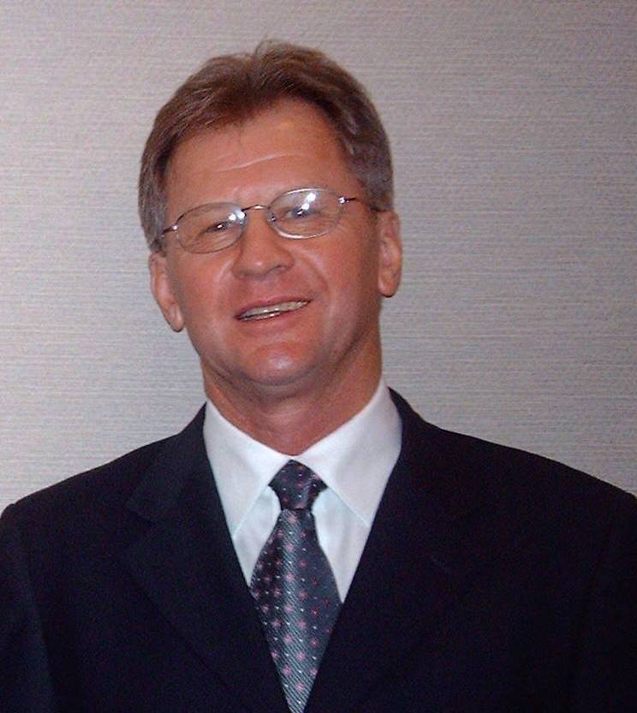
STRATEGY
What is your business?

Slide 5
STRATEGY
Sustainable Corporate Strategy
Vision- what do you want to become?
Mission- what is your business?
Asset base recognition
Future desired status
Under girding: 6-Sigma, ISC etc
How will you achieve your goals?

Slide 6
SIX STRATEGIES
1. Diversification Strategies (David)
Concentric
Conglomerate
Horizontal
2. Defensive Strategies
Joint venture, buy out, strategic
alliance, value chain alignment
Retrenchment
Divestiture
Liquidation

Slide 7
STRATEGIES
3. Vertical Integration Strategies
Forward
Backward
Horizontal
Keiretsu’s, Chaebol’s
4. Intensive Strategies (Ansoff)
Market penetration
Market development
Product development
Liquidation

Slide 8
STRATEGIES
5. Generic Strategies (Porter)
Differentiation
Cost Leadership
Focus
6. Avoidance Strategies
Management by Extrapolation
Management by Crisis
Management by Subjectives
Management by Hope

Slide 9
SWOT & TOWS MATRIX
S
W
O
SO Strategies
Use strengths to take advantage of opportunities
WO Strategies
Overcome weaknesses by taking advantage of opportunities
T
ST Strategies
Use strengths to avoid threats
WT Strategies
Minimize weaknesses and avoid threats

Slide 10
FOCUS ON THE PAST
Where we have come from
Learning from our past
ENVIRONMENT SCAN
Trends shaping our future
Implications of trends
PESTEL
FOCUS ON THE FUTURE
Best possible
future
STRATEGY
FOR THE
FUTURE
ACTION PLANS & IMPLEMENTATION
Purpose/Mission Values Issues Projects Big Ideas ??

Slide 11
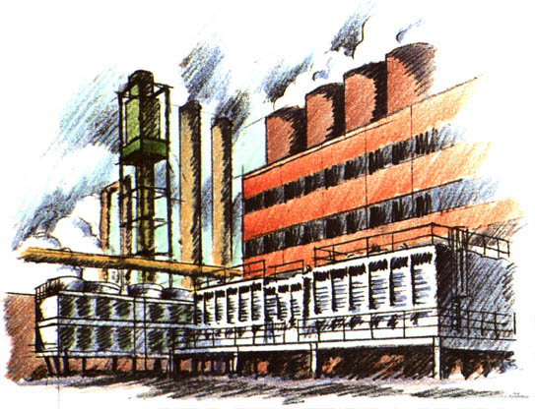
DYNAMIC FRAMEWORK
Internal Factors
People, Products,
Core competencies
Ambitions
Goals
Dynamic Strategy
Resources
External Factors
Global Markets, Needs
Technology, PESTEL

Slide 12
THE PEOPLE PICTURE
Operational
Results
People
Performance
4. Future
$ales,
profits, &
growth
3. High
performance
staff
High performance staff create best results
Staff development with harmony
Business Growth plan
Gap in $ales
results
Gap in Staff
Performance
2. Current
$ales
Current staff cause current results
1. Current staff
1 causes 2
3 will create 4

Slide 13
THE PROCESS PICTURE
1.
Vision & Mission. Purpose
Finance. Money in and out
Value chain. Where is value created
2.
Core competencies
Customers & Competitors
Segments: Targeting & Positioning
Branding
3
Products, Prices, Promotion, Place
Specific cyclical targets
Controls & feedback
This determines
staff development
4
HR
SHRM

Slide 14


THE TOTAL PICTURE
STRATEGY
Vision
PEOPLE GAP
Strategic Plan
1.
Vision & Mission
Finance
Value
Branding
2.
Core competencies
People, Processes, Procedures
Customers
Competitors
STP
Research
Marketing strategies
3
PPPP
Targets and goals
Controls & feedback
$
SHRM
GAP
GAP

Slide 15
Vision & Mission
SWOT and TOWS
Long Term Objectives
Alternative Strategies
Strategy Selection
Annual Objectives
Financial, Marketing
Review, Measure, Correct
Formulation
Implementation
Evaluation

Slide 16
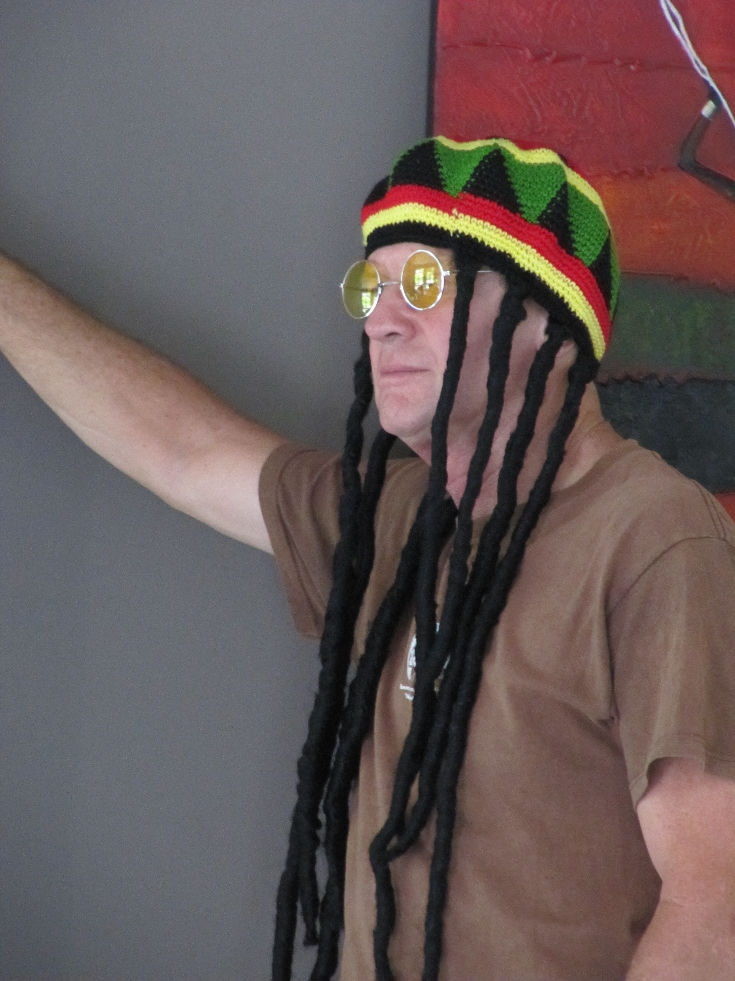
VALUE
Is your business value increasing?

Slide 17

VALUE
Value adding – what adds value
Value leakage – holes in the dam
Touch points – horizontal, vertical, internal & external
Product & service analysis
Department & function analysis
Upstream - downstream
Full ‘value chain’ thinking
Core competence

Slide 18
Value Chain Matrix
touch points
management structure
Upstream
Suppliers:
‘controlled’
assets
Downstream
Customers:
‘controlled’
assets
The Firm
Value leakage
Most business’s still operate with 19th Century ‘military’ pyramidal structures which don’t necessarily add value in the 21st century

Slide 19
PROFIT (P)
$400,000
SALES (S)
$1,000,000
ASSETS (A)
$800,000
EQUITY (E)
$200,000
OPS
P/S
40%
INV
S/A
125%
FIN
A/E
4:1
ROS
ROA
P/S x S/A
P/A
DuPont Formula
ROE
P/S x S/A x A/E
P/E
200%
50%
MV/BV
MVA= Market value added F= Finance M= Marketing VC= Value Chain
MVA = {F+M+VC}
EVA

Slide 20
Value Chain Analysis
Effective use of ‘controlled assets’- both upstream and downstream
Upstream
Producers Product Suppliers
Manufacturing
Raw materials logistics
Services
Downstream
Distribution Channels
Customers
Distributors
Wholesalers
Retailers
Reduced assets:
Higher ROA

Slide 21
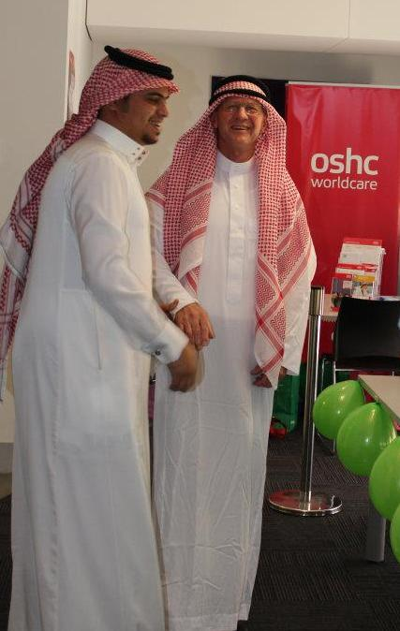
COMPLIANCE
Is your business protected?

Slide 22
COMPLIANCE
Is your entire organization legal?
OSHA, OHS, IEEE etc
ISO14000, ISO26000 standards
Conformance with Head Office
Taxation & year end reporting
SHRM: Staff compliance with objectives, standards and KPI’s
Going ‘Beyond Legal’ compliance

Slide 23
SHRM vs HR
Maintenance of staff records
Staff to ‘fit’ corporate strategy
Keeping all issues with staff ‘legal’
Strategic recruitment
Appraisals, KPI’s, BSC, KSF’s etc
Terminations
Staff measurement metrics
Function measurement metrics

Slide 24

OHS
Maintain OSHA- Occupational Health & Safety requirements and records
Staff training
Warning signage
Accident and injury prevention
Remember: Litigation is costly

Slide 25
TAXATION
Maintenance of all financial records
Timely filing of all tax returns within legal time requirements
Sarbanes Oxley compliance
Proper filing of all documentation for statutory periods
Hard copy and e-copy filing

Slide 26
HEAD OFFICE CONFORMANCE
Head office conformance requirements for global sustainability
Conformance with ‘Due Process’
Global strategic decision making
Appraisal and control capabilities
Common values and expectations
2-Way Communications feedback loop

Slide 27
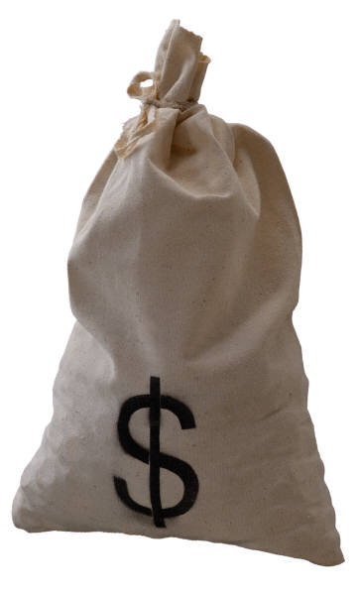
SERM SUMMARY
STRATEGY+VALUE+COMPLIANCE
THE THREE CRITICAL AREAS FOR SUCCESS

